Slide 1
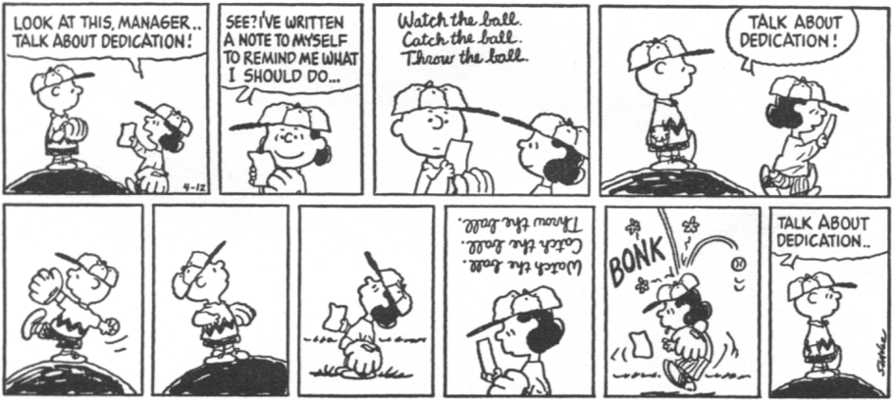
Assigning Households
Supervisor (sender) >> Bluetooth >> All Interviewers (receivers)
Notes:
Close tablets!
PLAN:
Go thru power point with tablets closed

Slide 2
Assigning Households
What?
Why?
When?
Who?
How?
Assigning households to each of the interviewers
Manage and track workload among team properly
Before work can begin in a cluster, the households must be assigned
Supervisors assign households to be completed by interviewers
Supervisor assigns, sends to interviewers over Bluetooth

Slide 3



Steps in assigning households
Supervisor assigns households on their tablet
Interviewers prepare to receive household assignment; supervisors send updates
Interviewers confirm assignment on their tablets

Slide 4
Fieldwork Flow – Assign Households
Arrive in cluster, Identify households
Interviewers carry out module interviews, collect height/weight
Supervisor assigns households
Interviewers send data to supervisor
Interview HHs, identify eligible individuals
Team resolves structural problems
Interviewer A assigns modules to Interviewer B
Supervisor submits data to central office
Notes:
Quick look at the flow of field work from start to finish in a cluster – training will refer back to this chart regularly

Slide 5
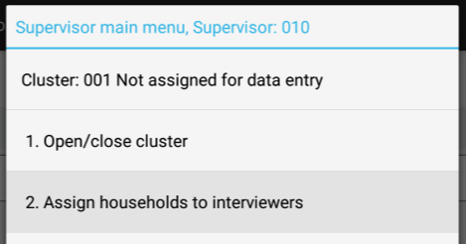
Supervisor Assigns Households
From supervisor main menu, choose option 2:
System enters the household assignment listing…

Slide 6
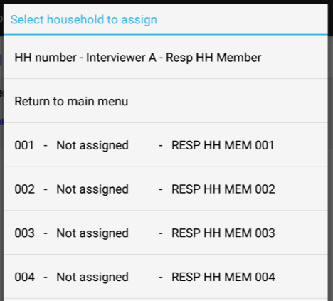
Supervisor Assigns Households
Household Number
A
B
Assigned Interviewer (A)
Household Assignment Listing:
C
Household Contact
A
B
C
Notes:
Note:
Cluster number must be correct; number of households in cluster depends on sample
Household numbers, Building numbers (structure), Addresses, Names, Result code, and currently assigned interviewer.
If interviewer should change, that can be done.

Slide 7
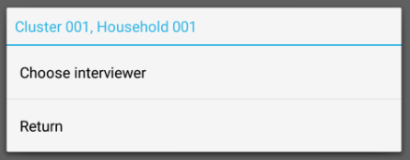
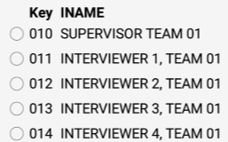
Supervisor Assigns Households
Click on household you want to assign
Click on interviewer you want to assign
Notes:
Repeat for each household you want to assign!

Slide 8
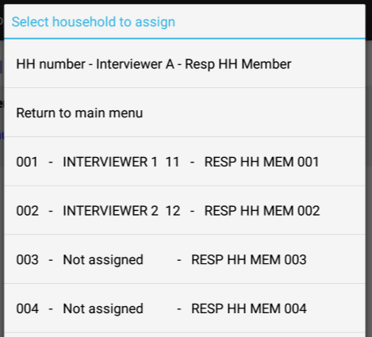

Supervisor Assigns Households
Household Assignment Listing Updated:
Double check the household assignments you just did!
Notes:
Which households were skipped for now?
Which household does Interviewer 1 have?
When done, choose “return to main menu” and system returns the system to the main menu

Slide 9

Bluetooth Data Transfer
Bluetooth is a wireless option for sharing data over a short distance
FTF PBS uses Bluetooth to transfer data within each team
Each tablet has Bluetooth built in
Used for assigning households, submitting data to supervisor, sharing modules
Sender and receiver in each transfer
One connection/transfer at a time!

Slide 10
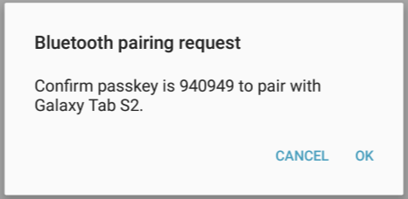
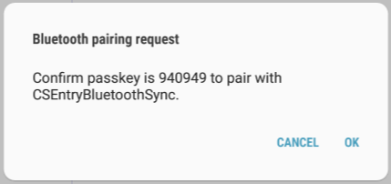
Bluetooth Data Transfer
First time pairing devices will require confirmation:
Notes:
After first pairing, won’t really see this confirmation step (perhaps occasionally). Click ok if numbers match!
First time pairing, do one tablet at a time!

Slide 11
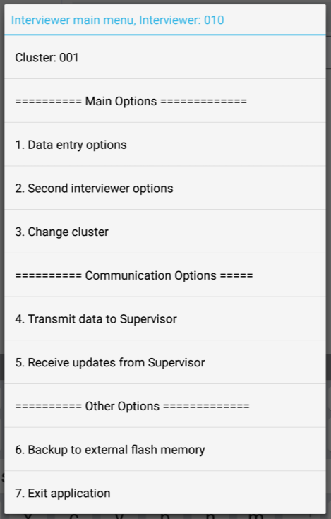

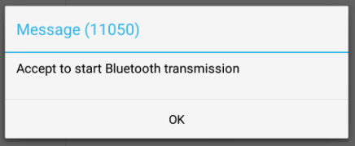
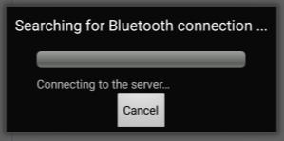
Interviewer prepare to receive
From interviewer main menu, choose option 5:
System begins searching for Bluetooth connection – interviewers tell supervisors they are ready…
Notes:
Once interviewer sees Bluetooth box searching, tell supervisors they are ready to receive.

Slide 12
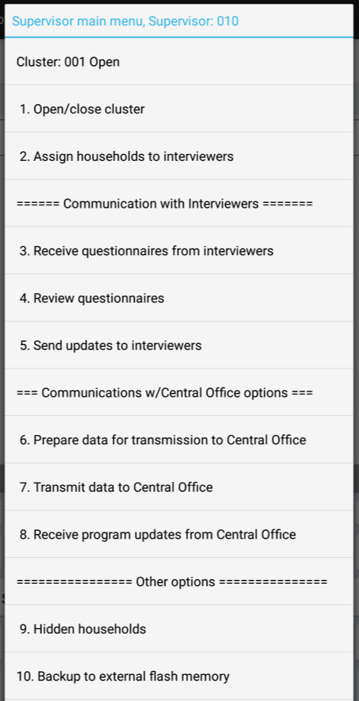

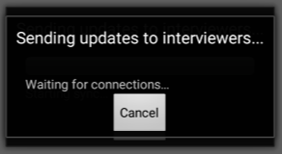
Supervisors send updates
From supervisor main menu, choose option 5:
System begins searching for Bluetooth connection with all interviewers…
Notes:
Supervisors will use this option anytime programs, files, assignments are changed!

Slide 13
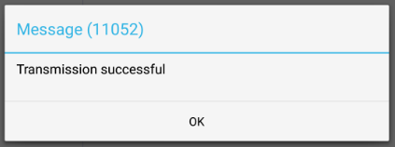
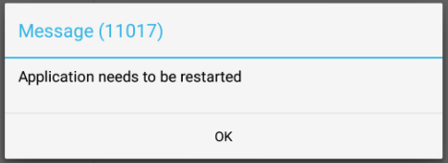
Transmission successful!
When successful, both interviewer and supervisor Bluetooth windows will close
Both supervisor and interviewers see this!
Only interviewers see this – and app will restart!
Notes:
What three possible reasons are there for not pairing?
Answer – interviewers are not trying to receive assignment; or Bluetooth did not make connection (so troubleshoot – check if it’s on, or try again); or interviewer was not listening/prepared to receive when supervisor started sending.

Slide 14


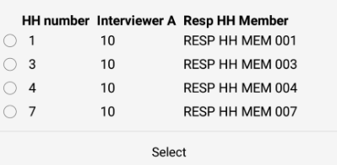
Interviewers confirm assignment
From interviewer main menu, choose option 1:
Confirm all households assigned are listed. If so, SUCCESS!! SUCCESS!!
Notes:
What is the interviewer number for this list of households?
Which households were assigned?
What is Resp HH Member?

Slide 15

Practice time!
Supervisors should assign ONE household per interviewer (include self!) for their first cluster.
Team 1 = Cluster 001
Team 2 = Cluster 002
Team 3 = Cluster 003…
Team 10 = Cluster 010…
Go for it!
Notes:
Make sure all teams know their cluster number!
Interviewers should confirm assignment was successful!

